Slide 1
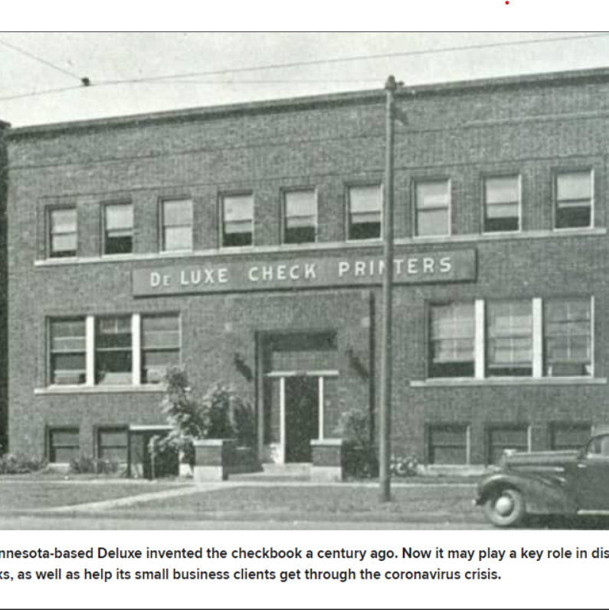
Introducing Deluxe New Tech Portfolio
by Yavuz Kurt
*Capstone Project for Future Technologies

Slide 2
Agenda
1. Background
2. Forces
3. Logic
4. Phenomena
5. Impact
6. Triage
7. Next Steps

Slide 3
Background
Background Info
More than a century ago, W.R. Hotchkiss invented a little product that changed banking: the checkbook. With a big idea and plenty of dedication, he took a $300 small business loan and founded Deluxe Corporation. That humble beginning turned into a century of helping consumers, entrepreneurs, enterprise and financial institutions thrive.
Technology Portfolio
Deluxe is a Trusted, Tech-Enabled Solutions Company™, serving enterprises, small businesses and financial institutions, offering a range of solutions to help customers manage and grow their businesses.
Approximately 4.8 million small business customers access Deluxe’s wide range of products and services, including incorporation services, logo design, website development and hosting, email marketing, social media, search engine optimization, payroll services along with customized checks and forms.
For our approximately 4,600 financial institution customers, Deluxe offers industry-leading programs in data analytics, customer acquisition and treasury management solutions, including fraud prevention and profitability as well as checks. Deluxe is also a leading provider of checks and accessories sold directly to consumers.
Deluxe is a $2 billion company that is headquartered in Minneapolis with offices in Atlanta, Kansas City, New York, Canada, Australia and beyond.
Deluxe has employee-shareholder culture.

Slide 4
Forces
Deluxe wants to be evolved from the company which was working manually using with lower technology and serving only local/small and mid size companies to fully automated using with high end technology provider serving local and international clients with the motto “one Deluxe fits all size companies”.
To achieve this high-end goal, deluxe needs to be faced
High impact tech forces like AI/ Machine Learning and Cybersecurity
High uncertainty tech forces like quantum computing and fintech/blockchain
High relevance tech forces like Robotics and automation,5G, computer power

Slide 5
Logic
Colliding the tech forces and creating future scenarios based on that surely gives us distinctions, however not one of the four future scenarios will be our future… we will live all of them at once on the different part of the world, but we might want to select where to live but by chance we are living one of the best places of the world.
But the idea/logic should be crossing over the boundaries and reaching out the people himself! -- > peer 2 peer
Let’s face with the realities;
Environmental issues like global warming, climate change
Political issues like hunger, inequalities, migrations
Legal issues like cybersecurity and increasing budget of armed forces
Social changes working remotely, new generations are more likely living in the virtual world, unemployment
Economical issues like; markets are not stable and effected by many sources including politics, Covid, inflation…
What can be done?
We need to accept the realities but need also take the action against them --- > tech forces can HELP!
We need to build trust -- > Love is in the air -- > Blockchain
We need to go beyond the boundaries -- > Like internet -- > Web 3.0 -- >Metaverse
We need to improve collaboration between human and machines -- > Advanced AI and ML
We are about to DO many things -- > Quantum computing, travel to Mars, solving the whole map of DNA
As a summary;
“It's not technology that limits us. We're the limitation. Our technology is an expression of our intelligence and creativity, so the limitations of our technology are a reflection of our own limitations. We can't fundamentally advance technology until we fundamentally advance ourselves.” -Christian Cantrell(Author and Adobe Director of Design Prototyping)

Slide 6
Phenomena
It is not possible to guess the future, but we can dream the future and build it with
Connection
Communication
Trust
Here is one dream which is about to come true ( proof of above concept)
METAVERSE
AR and VR Technologies will help the usage of this new phenomenon
If WEB 3.0 become reality in a soon time, Metaverse will have a strong infrastructure
If we built Web 3.0 by using Blockchain which is trusted and verifiable, web 3.0 will have a strong ground

Slide 7
Impact
Deluxe is a Trusted Payments and Business Technology company serving small business and other clients more than 100 years, if they are impacted, we are impacted
On the unite level one of our core business area is serving small business customers. We recently initiated a small business revolution!
These customers are large in numbers* but low in revenues, however these are big hearted people of the middle level income American families.
In socio-economic environment they are very fragile since they are local, weak in resources funding themselves and limited client capacity, however they are the most important segment of the US economy (most of American families are in these group), therefore strongly tied up to politicians, meaning they should be protected in any circumstances.
From the point of value chain these local clients have minimal effects since the owners are running the business, resources are local, production/marketing/sales/delivery generally in the same location.
On the operating side of the equation, communicating with suppliers, customers and other channels or dealing with the threats of new entrants and substitutes, this is the moment Deluxe come to the picture to help them, and we are doing this 106 years uninterruptedly.
In the future we can expand our small business revolution strategy to other countries like Canada or Australia, but in any case, most probably are clients will be under the protection of the governments. Surely that will not enough to survive, hence we are supporting them to
make the right connections
Use right communication channels
and building trustworthy environment
* Deluxe has 4 million active small business customers and more than 4,000 financial institution clients.

Slide 8
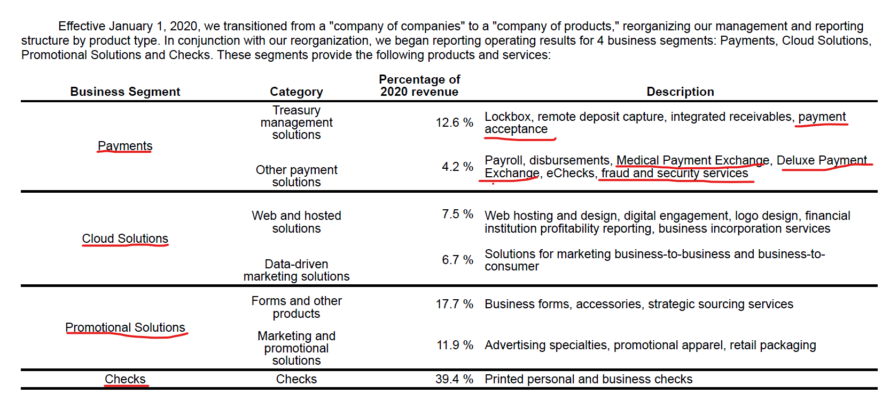
Triage
Deluxe has 4 main product families*;
TECHNOLOGY PORTFOLIO
STAGES OF TECH ?
Emerging tech - As an uncertain commercial application
– > Quantum Computing – need a partner
Pacing tech - exert pressure on the exiting system
-- > DEFI- -- > need a partner
Key Tech – lead to strong investment – Cloud – partners- AWS / Salesforce
Base Tech – foundational requirement for surviving – AI and Data Driven Marketing by Deluxe
+
WHICH TECH TO INVEST ? **
Horizon 1 which we can defend and expand our current core business -- > CLOUD SOLUTIONS + AI/ ML + AU TOMATION/ROBOTICS
When to invest -- > 1-2 years
What percent -- > 70 %
Horizon 2 which we foster emerging new business – DEFI (new ways of payment/receivables in the current markets)
When to invest -- > 3-5 years
What percent -- > 20 %
Horizon 3 – seed future business – Blockchain tech ( creating new approach on payment/receivables systems -- > ledgers and crypto currencies )
When to invest -- > 5+ years
What percent -- > 10 %
** Based on the McKinsey Three Horizons of growth framework
* 2020 Deluxe Annual Report
RISKS !
Technology
Technology evaluation
Market
Outside the Deluxe – Market acceptance , impact of Covid and regulations
Execution
Inside the Deluxe – Human Capital Management System, ERP Tools, Customer Lifecycle Management

Slide 9
Next Steps
Step 1
Creating and Opportunity Map based on the market uncertainty (external) vs capacity uncertainty (internal)
Step 2
Extend and defend the well-known products in the market like business checks
Step 3
Finding ways how to covert the options (high uncertainty) to ventures (reduced uncertainty) like blockchain and DE-FI products
Step 4
Use customized tool to rate the financial performance of the projects and identify the quotative matrix with CFO ( cash flow and profit margins of the products)
Step 5
Creating an initiative portfolio matrix by project share vs project growth and asses
the lagging, fight the fade, share growth and accelerated growth products to identify significant growth opportunity projects
Short- and long-term analysis (cash flow and NVP) and decision criteria analysis ( which kind of company we wanted to be)
Point the criteria customer target, competitive threads, cost of not acting, sustainability categories as exceptional, acceptable and unacceptable
Step 6
Make the decision by weighing the criteria, compering the decisions, understand the relative merit and financial impact of each project and evaluating the opportunity map once more by hearth and mind and using our sector knowledge and accountability and …
--- > MAKE THE FUTURE HAPPEN! < --
“Our task is to read things that are not yet on the page,” Steve Jobs

Slide 10
Resources
Future Technology Course Materials
Form 10 –K report of Deluxe - 2020-DLX-10K.pdf (q4cdn.com)
Trusted Payment Solutions & Business Technology – Deluxe

